Slide 1

Carbon Dioxide and Helium Gases in New Mexico: Distribution and Relation to Other Gases in the Reservoir
Ron Broadhead
New Mexico Bureau of Geology and Mineral Resources
A Division of New Mexico Tech
GSA Annual Meeting, September 26, 2016

Slide 3
Bravo Dome
CO₂ field
3.5 TCF production,
99% CO₂;
Tr – 0.1% He

Slide 4
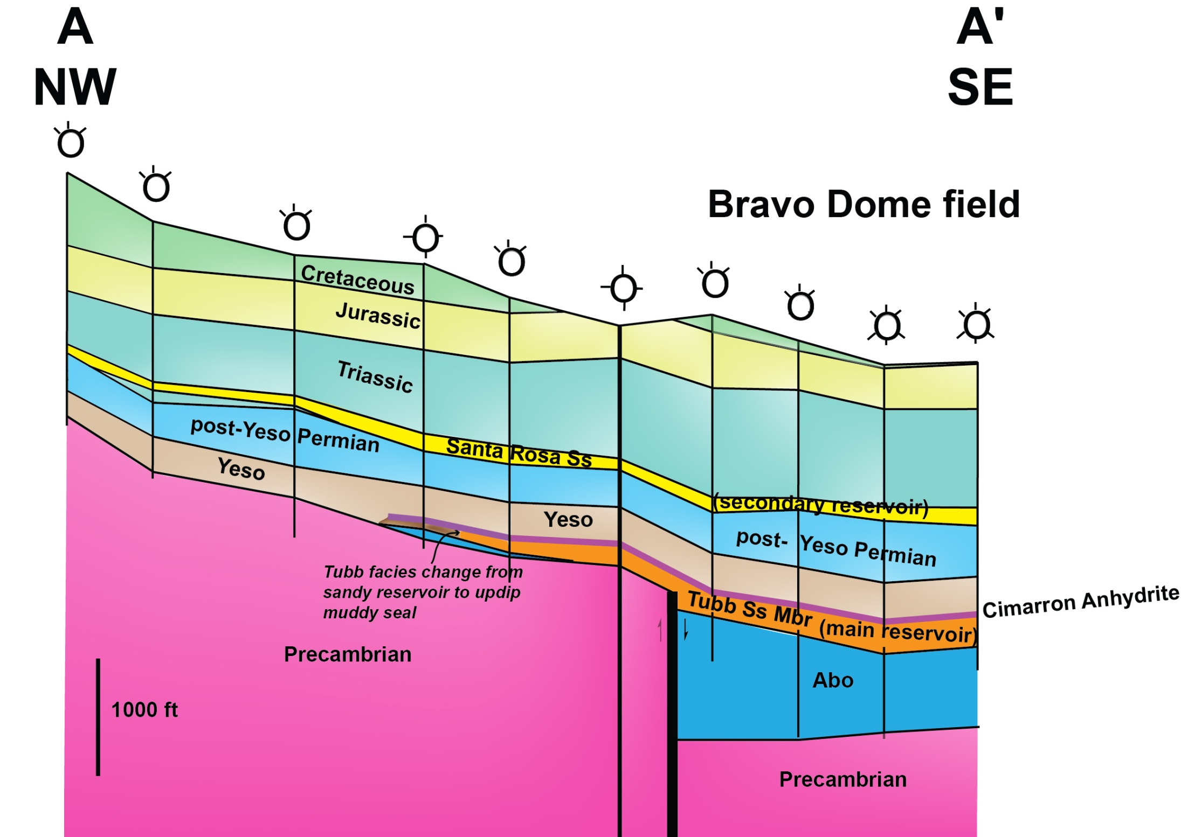

Slide 8
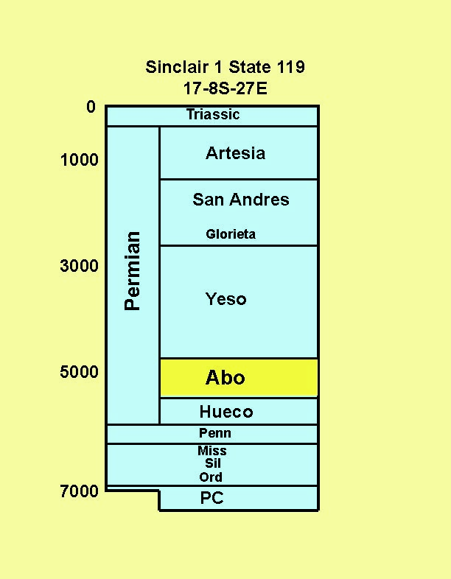

Slide 9
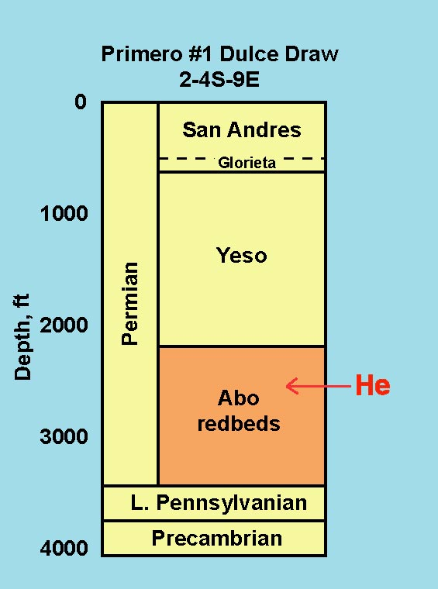

Slide 10
Helium isotopes
Chupadera Mesa
R = ratio of ³He/⁴He normalized to air (1.39 x 10⁻⁶)
R_{chupadera} = 0.515
For mantle He 6 < R < 10 (Oxburgh et al, 1986)
For most crustal He R < 0.08 (Oxburgh et al, 1986)
Strongly suggestive that part (6.2%) of Chupadera He is mantle derived.
Remainder of Chupadera He is crustal.

Slide 14
Summary
Gases that contain >99% CO₂ have been produced from the Bravo Dome field, where the main reservoir is a Lower Permian sandstone. Trap is combination structural-stratigraphic. Production is 3.5 TCF.
The CO₂ is juvenile, derived from degassing of rising magmas.
Commercial production of helium in New Mexico has been from 8 small oil & gas reservoirs on the Four Corners Platform. Cumulative production has been 1 BCF He.
⁴He is dominant and is sourced by radioactive decay in the crust, chiefly from granitic rocks.
³He is juvenile, derived from the mantle
In Lower Permian reservoirs in southeast New Mexico, He percentage increases with increasing proximity to strike-slip faults which presumably acted as migration pathways from the basement.

Slide 15
Summary (cont’d)
Lower Permian sandstone reservoirs under Chupadera Mesa contain gases with up to 3.4% He, the highest concentrations in New Mexico outside of the Four Corners Platform
He isotope analyses suggest that part of the Chupadera He is crustally derived and part is juvenile, from the mantle.
He content of gases decreases with increasing hydrocarbon content, suggesting that migrating hydrocarbons dilute the He in the reservoirs.
He content > 1% is uncommon in reservoirs with CO₂ > 5%, suggesting that volcanic CO₂ charging dilutes crustal or mantle-derived He.
He content of gases increases with increasing N₂ content, suggesting that incomplete reservoir charge with N₂ or CO₂ may be necessary for high He gases.

